Slide 1
DSC-530 Term Project
Harlan G Wittlieff
College of Science and Technology, Bellevue University
DSC-530-T302: Data Exploration and Analysis
Neerja Sahu
11/20/2021

Slide 2

Problem Statement
Do physical characteristics (height, weight, and gender) impact Pokémon base stats?

Slide 3

Selected Variables
attack
This variable is the attack value for an individual Pokémon
defense
This variable is the defense value for an individual Pokémon
hp
This variable is the number of hit points for an individual Pokémon
weight_kg
This variable is the weight of an individual Pokémon in kilograms
height_m
This variable is the height of an individual Pokémon in meters
percentage_male
This variable represents the percent of the species of Pokémon that is male

Slide 4
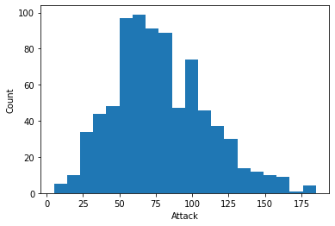
Selected Variables - attack
Mean
77.9
Mode
100
Standard Deviation
32.2

Slide 5
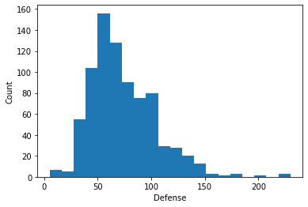
Selected Variables - defense
Mean
73.0
Mode
50
Standard Deviation
30.8

Slide 6
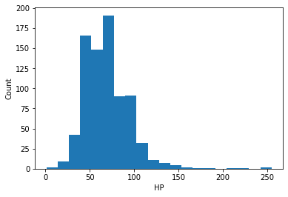
Selected Variables - hp
Mean
69.0
Mode
60
Standard Deviation
26.6
There are a couple of outliers with high HP values, however they will be included in this analysis

Slide 7
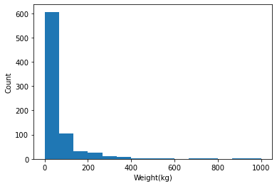
Selected Variables - weight_kg
Mean
61.1
Mode
15
Standard Deviation
108.5
There are a couple of outliers with high weights, however they will be included in this analysis

Slide 8
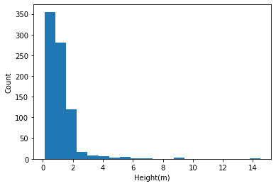
Selected Variables – height_m
Mean
1.2
Mode
0.6
Standard Deviation
1.1
There are a couple of outliers with high heights, however they will be included in this analysis

Slide 9
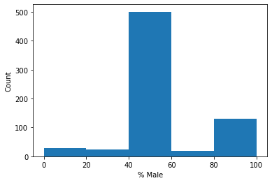
Selected Variables – percentage_male
Mean
55.2
Mode
50
Standard Deviation
20.3

Slide 10
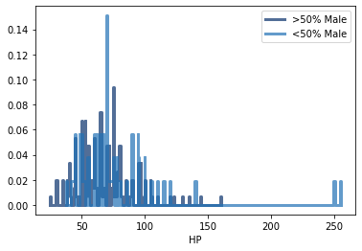
Analysis – HP PMF
PMF is shown for HP of Pokémon that are primarily male vs Pokémon that are primarily female
Primarily female Pokémon have a few high health outliers

Slide 11
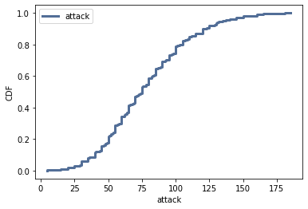
Analysis – attack CDF
The CDF for attack is very evenly distributed
There is a good balance of data from Pokémon with any given attack

Slide 12
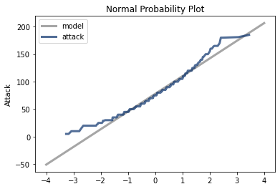
Analysis – attack Normal Probability Plot
The Normal Probability Plot for attack shows that attack is normally distributed

Slide 13
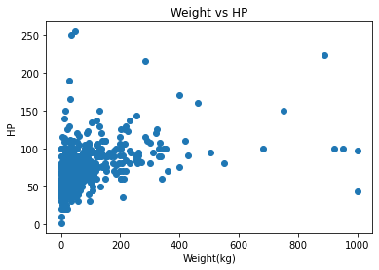
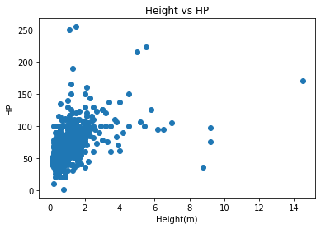
Analysis – Variable Comparison
Corr = .43
Corr = .48

Slide 14
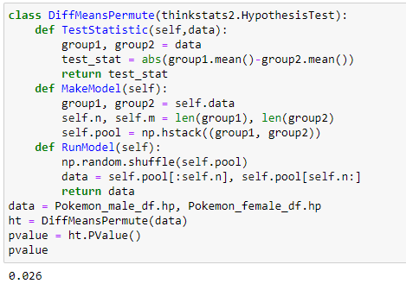
Analysis – Difference in Means
A difference in means test was performed between the hp values from our primarily male data and the hp values from the primarily female data
The p-value resulting from the test was 0.026 meaning the difference is statistically significant

Slide 15
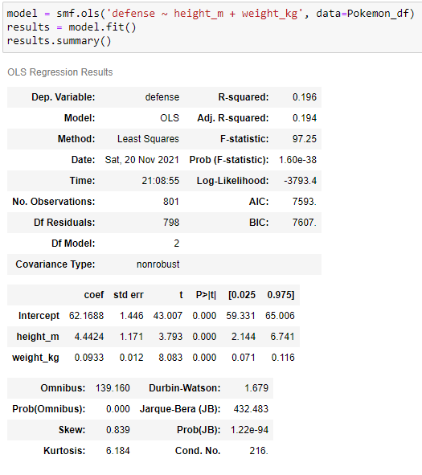
Analysis – Regression Analysis
A regression model was created that predicts attack based on height_m and weight_kg
The model can account for 20% of the variability in attack

